Slide 1

Principles of Compiler Design
Individual Assignment-2
Zelalem Getahun 1508462

Slide 2
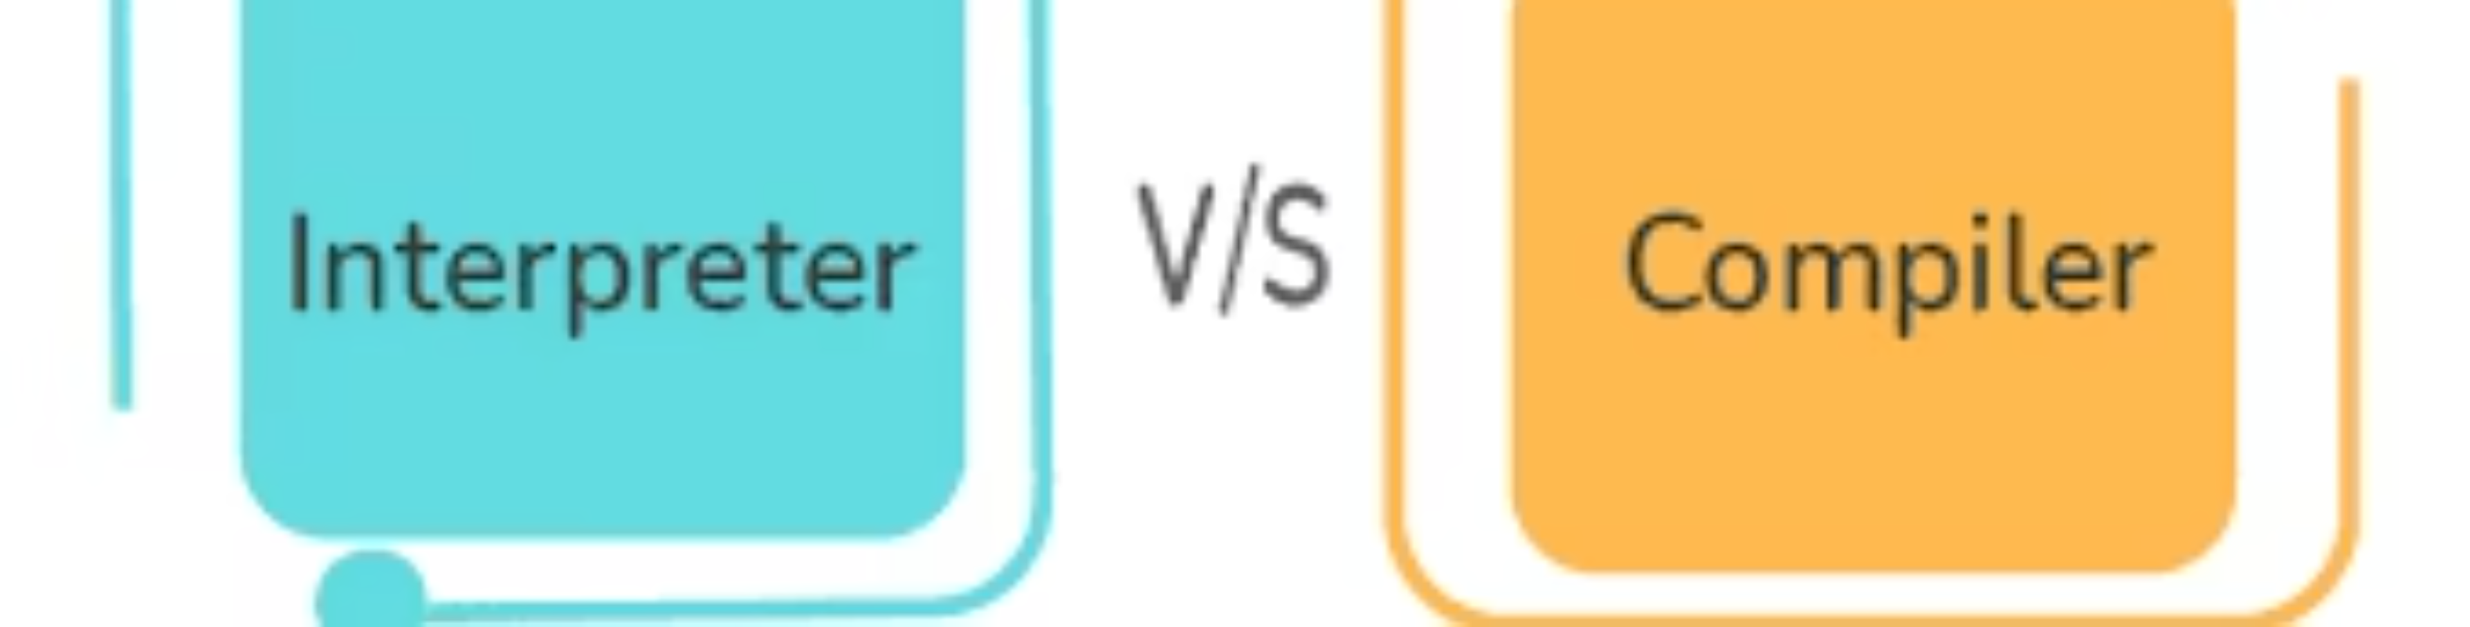
What is a Compiler and How Does it Differ from an Interpreter?
Understanding the fundamental differences between compilers and interpreters is crucial for any aspiring computer scientist. Both are essential translation tools in programming, but they operate distinctively and impact how software is developed, debugged, and executed.

Slide 3

What is a Compiler and How Does it Differ from an Interpreter?
This detailed presentation explores the intricate world of programming language translation tools. We will delve into their core working mechanisms, highlight their critical differences, and examine their real-world applications across various software development scenarios. By the end, you'll have a clear understanding of when to choose a compiler over an interpreter and vice versa.

Slide 4
Introduction to Language Translators
At the heart of modern computing lies a fundamental challenge: computers operate on binary machine code, a language far removed from the human-readable programming languages we use. To bridge this critical communication gap, language translators are indispensable tools. They act as intermediaries, converting our high-level instructions into a format the machine can execute.
Bridging the Gap
Essential Translation Tools
Strategic Choice
Computers cannot directly understand human-readable programming languages. They only comprehend binary machine code.
Two of the most important translation tools are the Compiler and the Interpreter.
Understanding their differences helps developers choose the right tool for optimal efficiency, development speed, and execution behavior.

Slide 5

What is a Compiler?
A compiler is a system software program designed to translate an entire high-level programming language into machine code in a single, comprehensive operation. Unlike interpreters, compilers process the entire source code before any part of the program is executed.
Full Program Translation
Executable Output
Error Checking & Optimization
The entire source code is translated into machine code before execution begins.
Generates a standalone executable file that can run independently.
Performs extensive error checking and applies powerful optimizations to enhance performance.
Fast Execution
Performance-Critical
Once compiled, the program runs significantly faster as no further translation is needed.
Commonly used in applications where execution speed and efficiency are paramount, such as operating systems and game engines.

Slide 6

Compiler Working Process
The compilation process is a sophisticated journey, involving multiple structured phases. Each phase plays a crucial role in transforming high-level source code into efficient, executable machine code.
1. Lexical Analysis
Breaks down the source code into a stream of tokens, identifying keywords, identifiers, and operators.
2. Syntax Analysis
Constructs a parse tree to check the grammatical structure of the program against the language's syntax rules.
3. Semantic Analysis
Ensures the logical correctness of the program, checking for type compatibility and proper variable usage.
4. Intermediate Code Generation
Converts the parse tree into an intermediate representation (IR), a machine-independent code.
5. Optimization
Applies various techniques to improve the efficiency and performance of the intermediate code.
6. Code Generation
Produces the final machine code specific to the target architecture, ready for execution.
Once compiled, the resulting executable program can run numerous times without the need for recompilation, saving significant time during repeated execution.

Slide 7
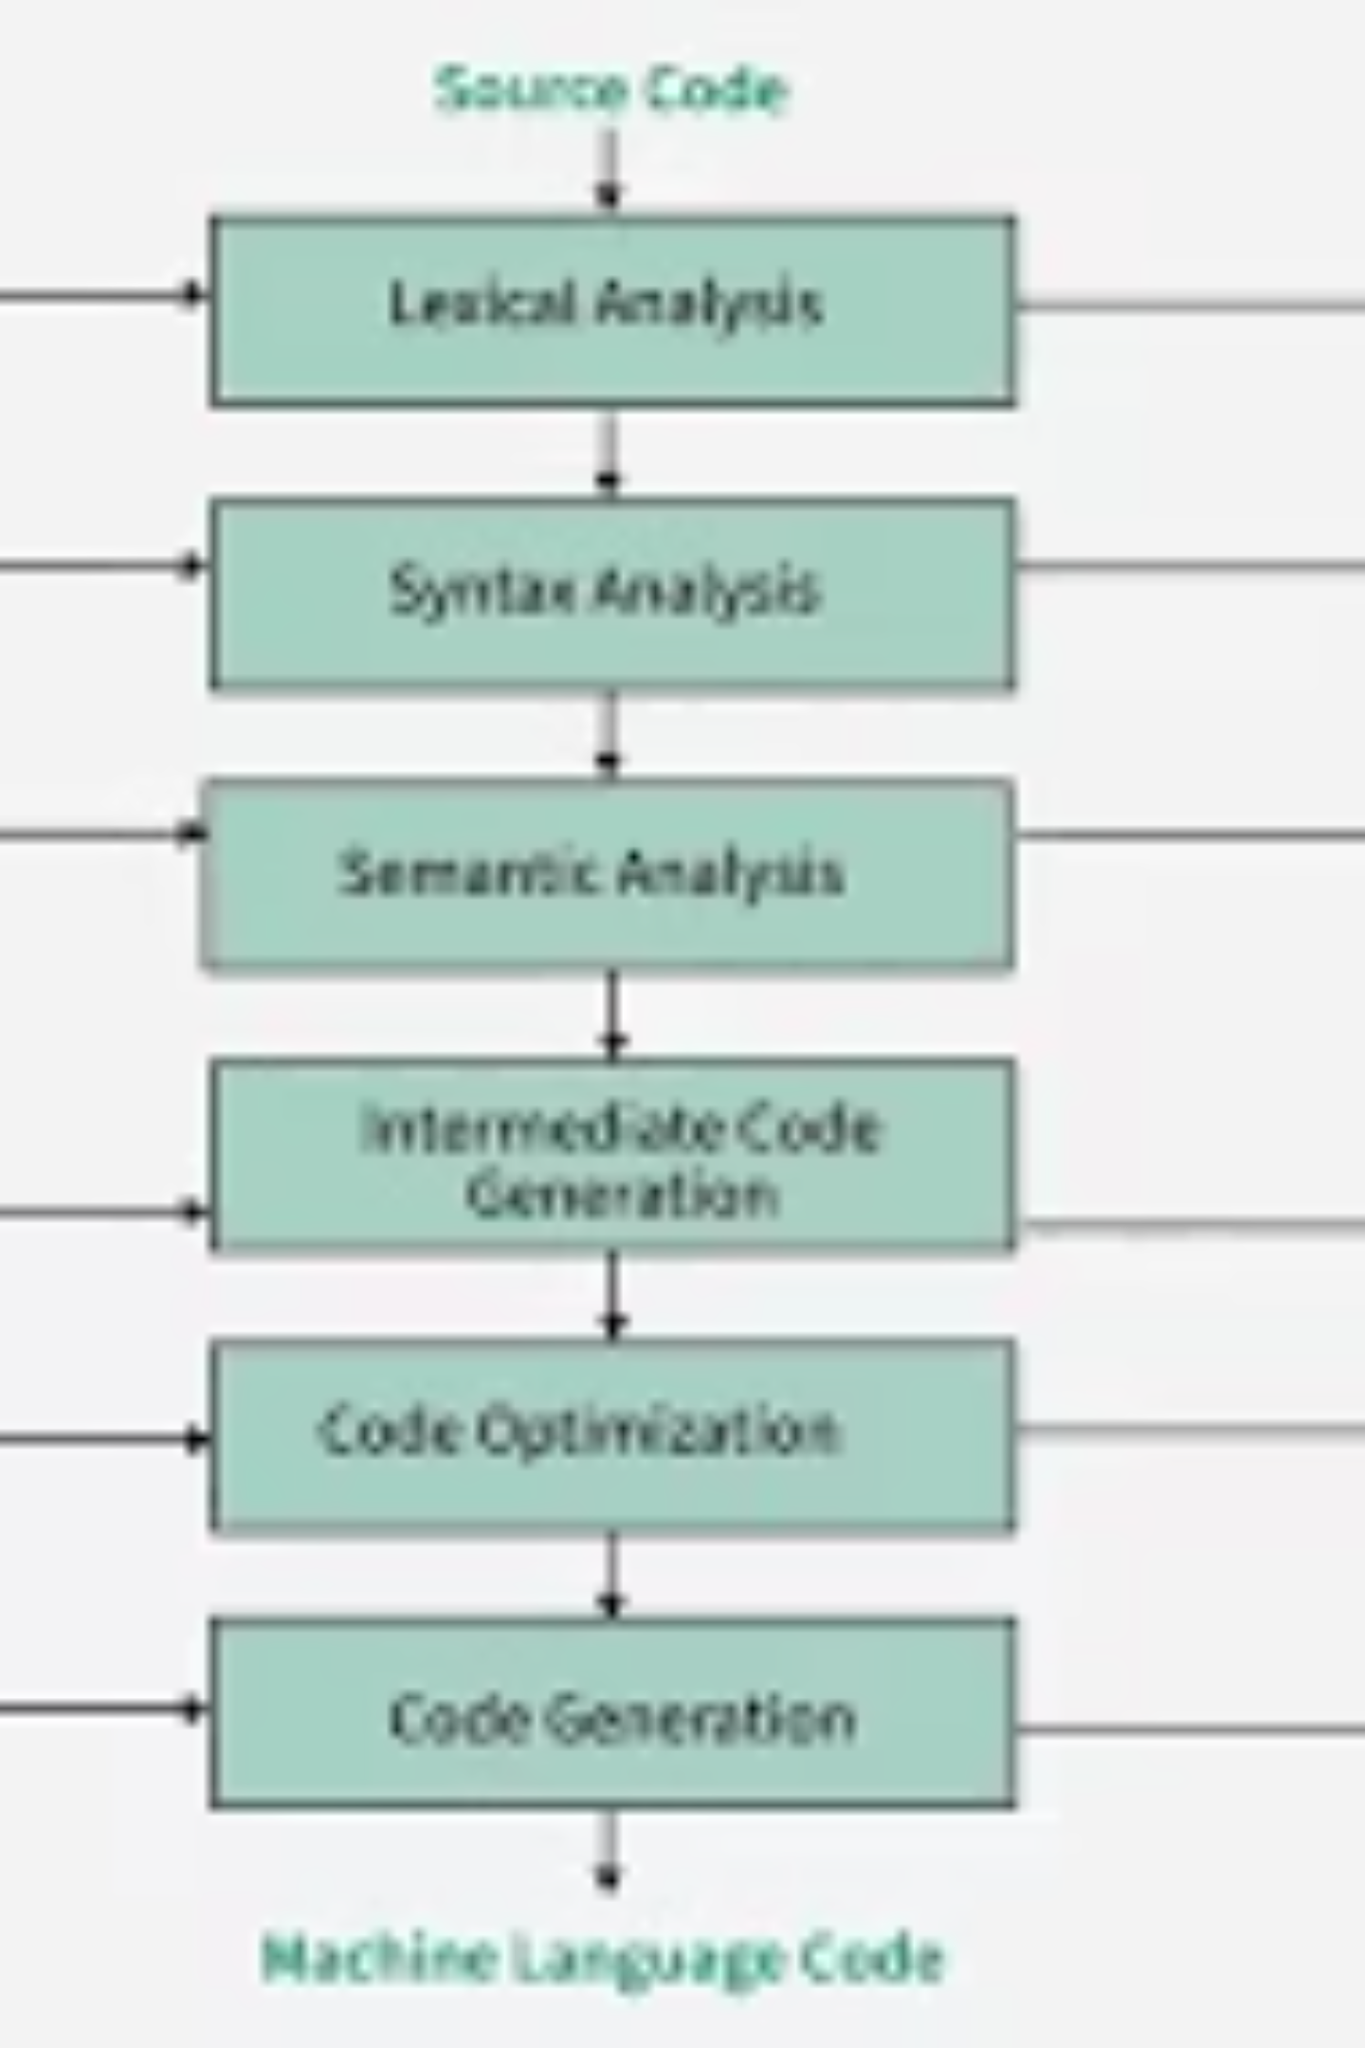
Visual Representation of Compiler
This simplified diagram illustrates the journey of source code through the compiler's various phases, culminating in a ready-to-execute program. Each step transforms the code closer to a machine-understandable format.
The visual flow from human-readable code to machine code underscores the complexity and power of compilers in modern software development.

Slide 8
What is an Interpreter?
In contrast to compilers, an interpreter is a program that translates and executes source code instruction by instruction, line-by-line. It does not produce a separate, standalone machine code file. This fundamental difference leads to distinct characteristics and use cases.
Line-by-Line Execution
Immediate Error Detection
No Executable Output
Translates and executes program statements one at a time, sequentially.
Stops execution immediately upon encountering an error, making debugging easier.
Does not generate a separate executable file; the source code is translated every time it runs.
Simplified Debugging & Testing
Scripting & Rapid Development
The interactive nature supports quicker iteration and easier identification of issues.
Often favored in scripting languages, educational environments, and scenarios demanding rapid prototyping.

Slide 9




Interpreter Execution Flow
The interpreter's execution flow is characterized by its continuous cycle of reading, translating, and executing each line of the source code. This process continues until the entire program has been executed or an error is encountered.
Read Source Code
Translate to Machine Code
The interpreter reads a single line or statement from the source code.
It translates that specific line into an intermediate code or directly into machine instructions.
Execute Instruction
Repeat
The translated instruction is immediately executed by the machine.
This cycle repeats for the next line, continuing until the program ends or an error occurs.
This dynamic, real-time translation makes interpreters highly flexible for development and testing, though typically at the cost of execution speed compared to compiled programs.

Slide 10
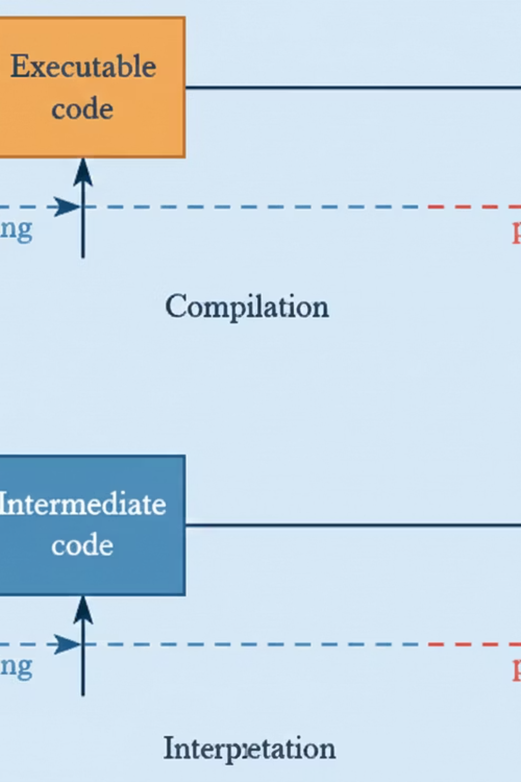
The Compiler vs. Interpreter Landscape
This comprehensive diagram visually summarizes the key distinctions and interactions between compilers and interpreters. It highlights their different approaches to source code translation, error handling, and the resulting execution outcomes.
Understanding this landscape is essential for making informed decisions in programming, allowing developers to leverage the strengths of each tool to suit specific project requirements.

